Slide 1
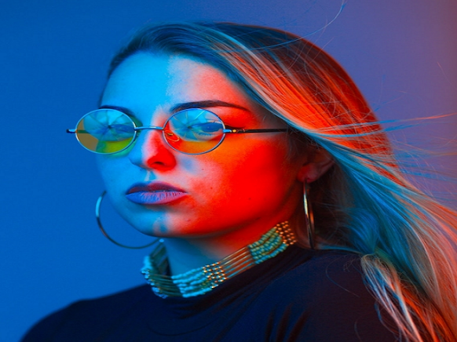
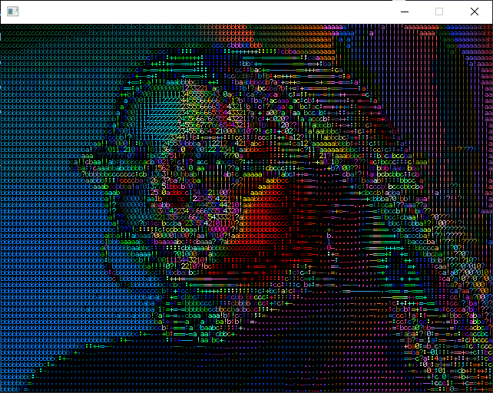
FPGA
Final project presentation
ASCII camera filter

Slide 2
Agenda
Camera module brief and requirements.
Design flow.
Main block diagram.
Components.
Block design.
FPGA.
Main block diagram.
Vivado block diagram.
Clock domains.
Main components:
Camera.
I2C configuration.
BRAM.
VGA driver.
ASCII filter.
Debag and useful tools for accomplish project.
Example video.

Slide 3
Camera module brief
Project main purpose:
Sample live stream from camera module and stream live video to VGA port.
The live stream will have 2 modes:
Regular mode.
ASCII filter mode.

Slide 4

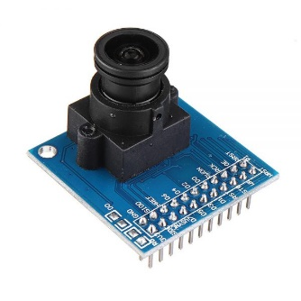
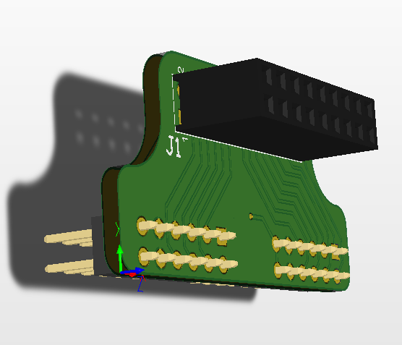
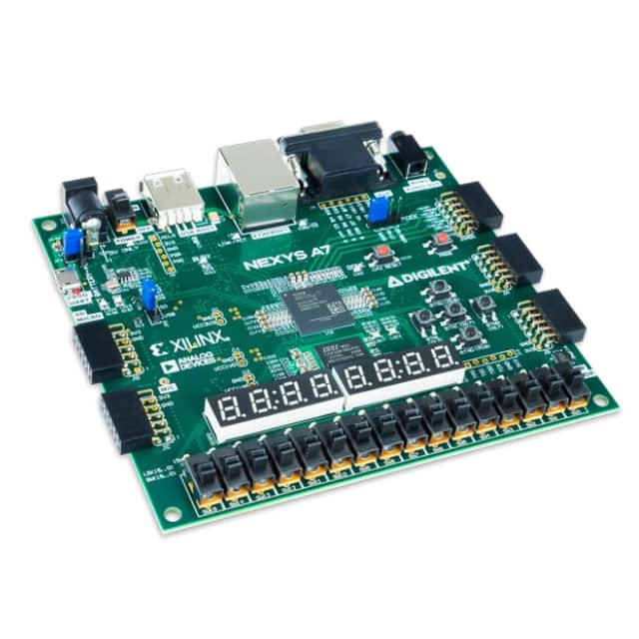
Design flow
OV7670 to PMOD adapter
NEXYS A7 Board
OV7670
VGA Monitor

Slide 5


FPGA -> Main block diagram
OV7670 camera module
OV7670 to 2x PMOD con
SDA (Write only)
FPGA
I2C Sender + Registers buffer
SCL
VGA signal driver
Hsync
Vsync
Red[3:0]
VGA Monitor
Green[3:0]
A
DSP
Blue[3:0]
XCLK 24 MHz
OV7670 Capture and filter
B
P
Address [18:0]
PCLK
Data[11:0]
HS
WEA
Dual port RAM Full frame buffer 12x307200
Address [18:0]
VSYNC
Data [11:0]
Data[7:0]
24MHz
100MHz
PLL
100MHz
25MHZ

Slide 6
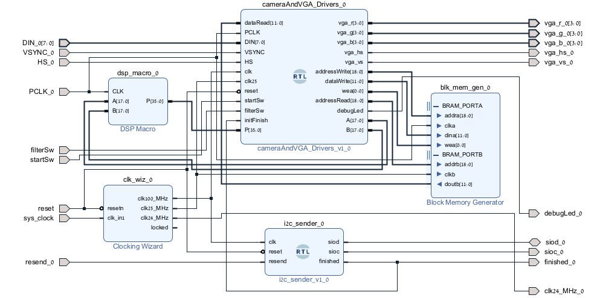

Slide 7
Clock Domains
Input clock – 100MHz from oscillator on board.
XCLK – 24 MHz.
I2C module – 100 MHz.
VGA – 25 MHz.
DSP – 24 MHz.
BRAM:
READ – 25MHz.
Write 24 MHz from PCLK.

Slide 8
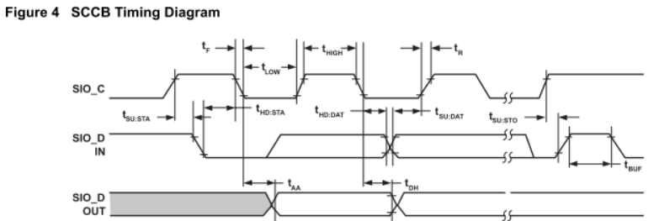
Main component – OV7670
OV7670 is versatile camera and have multi format to work with, I chosen to work on RGB565 30FPS format.
OV7670 is configure via I2C (like) protocol.
XCLK is the input CLK pin.
PCLK, HS, VSYNC and D[7:0] are the frame output pins.
Camera also have RESET and POWER DOWN pins and are not in use in this project.

Slide 9
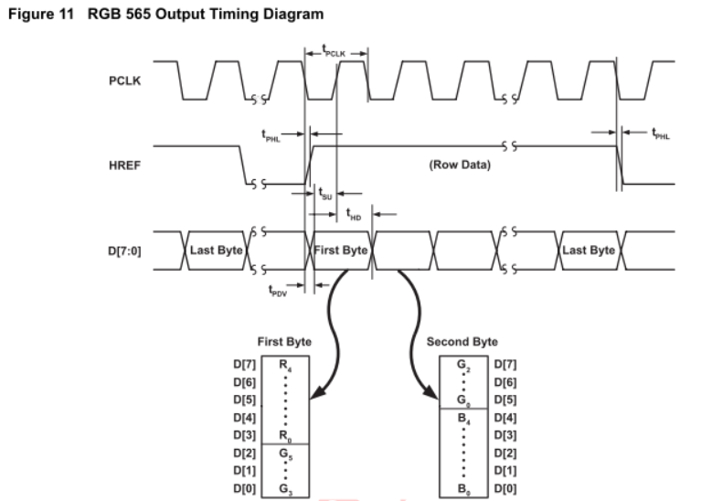
Main component – OV7670 RGB565
Frame timing:
Frame start in VSYNC RISING edge and end in FALLING edge.
Line pixels are read when HS is in HIGH mode.
Etch pixel is combination of 2 byte of data (2 clock cycles).
Red is 5 MSB bits.
Green is 6 next bits.
Blue is next 5 bits.

Slide 10
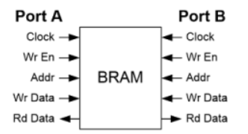
BRAM – dual port ram
Dual port ram give user the possibility to read and write data simultaneous.
Camera capture module is stored full frame as is reading it in normal mode, in filter mode the frame is stored after manipulation.
VGA driver is reading frame data and send it to VGA port.

Slide 11
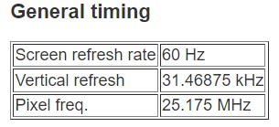
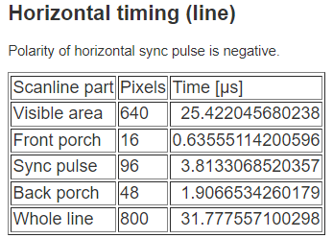
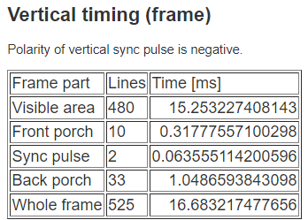
VGA Driver
NYEXUS A7 board is implementing VGA with 5 signals:
HSYNC – horizontal sync.
VSYNC – vertical sync.
RED - 4 bits.
Green – 4 bits.
Blue – 4 bits.
I chosen to work in “VGA Signal 640 x 480 @ 60 Hz Industry standard timing”

Slide 12
ASCII Filter
Our frame is 640x480 pixels, for every ASCII character is compose from box of 8x5 pixels.
Every 8 lines is divide into boxes, etch line have 640 / 5 = 128 boxes.
For every box we calculate average RED, GREEN, BLUE and density (d = (red + green + blue) / 3).
Density is map to number between 0 to 13 ( 14 ASCII character ).
After density is calculate we select ASCII character from constant list and fill the box with the character with the average color that we calculate.
Every finish line is stored in BRAM while we calculate the next 8 lines.

Slide 13
ASCII Filter
Chars[] = {‘.’, ‘,’, ‘-’, ‘=’ , ‘+’ , ‘:’ , ‘!’ , ‘1’ , ‘3’ , ‘5’ , ‘7’ , ‘9’ , ‘#’ , ‘@’}
D = (red_avg + green_avg + blue_avg)/3; D = map D from 0 : 48 to 0 : 13;
8 Lines of frame
0
4
639
Fill box with character from chars list.
0
…..
…..
…..
…..
…..
…..
…..
8
…..

Slide 14
Debag and useful tools for accomplish project.
For converting photo to RGB565 format I used website: “This web site”
For implementing OV7670 capture driver I program a C program that convert RGB565 array of pixels to TEXTIO file and using test Bench to manipulating I/O to simulate camera module.
Using the same test bench I write file with the same RGB565 format and with file compering I test for good result.
Since I used most of the BRAM I didn't have room for micro Blaze so I used STM32 micro controller to test camera configured registers.
A lot of simulation and simulation and simulation.

